Slide 1
Pramerica / LYIT DevOps Interns Development Pipeline
DevOps Interns
Presented by: Michael McFadden
Vincent Kelly
Owen Lyons
On behalf of: Nico Long
Liam Dorrian
Matthew McColgan
Anthony Quinn
Eugene Robb
John Fullerton
Nicky Duffy
Patrick McGee
Stanley Ohai
What we’ve learned
Mentors / Buddies
Formal Training
Interviews
New Roles
What’s Next?

Slide 2

What is DevOps?
Pramerica / LYIT DevOps Interns Development Pipeline

Slide 3
What DevOps is not!
Pramerica / LYIT DevOps Interns Development Pipeline
Not a thing
Not a product
Not a complete solution
Not a “Jack of all trades”
You can’t buy DevOps

Slide 4
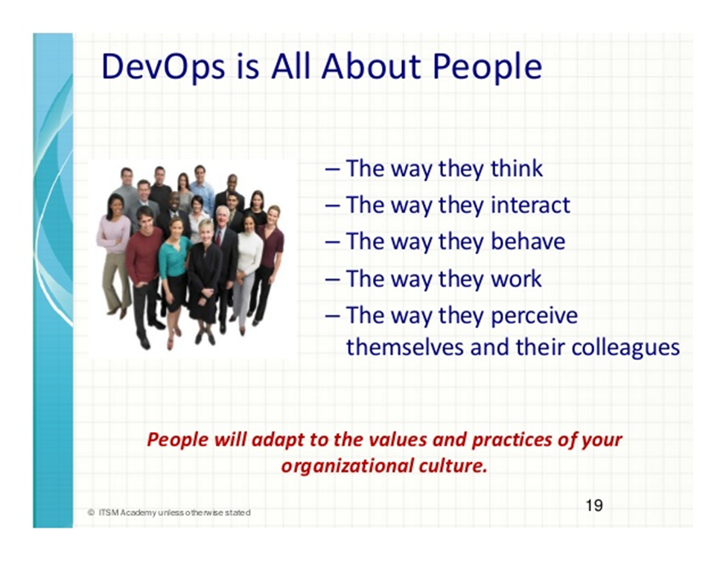
Pramerica / LYIT DevOps Interns Development Pipeline

Slide 5
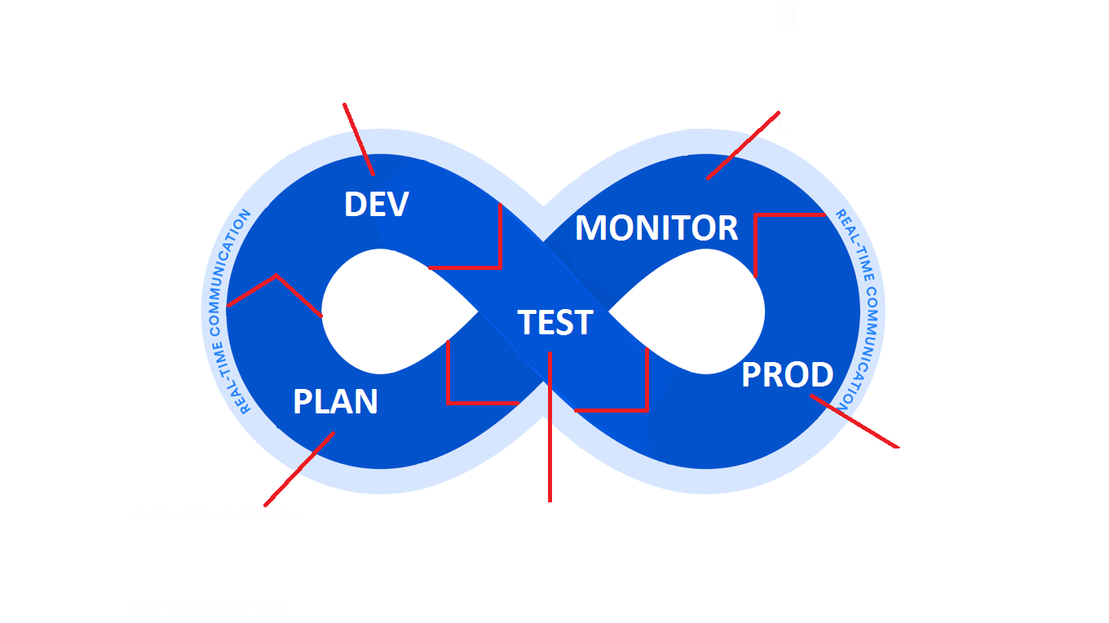
Pramerica / LYIT DevOps Interns Development Pipeline

Slide 6
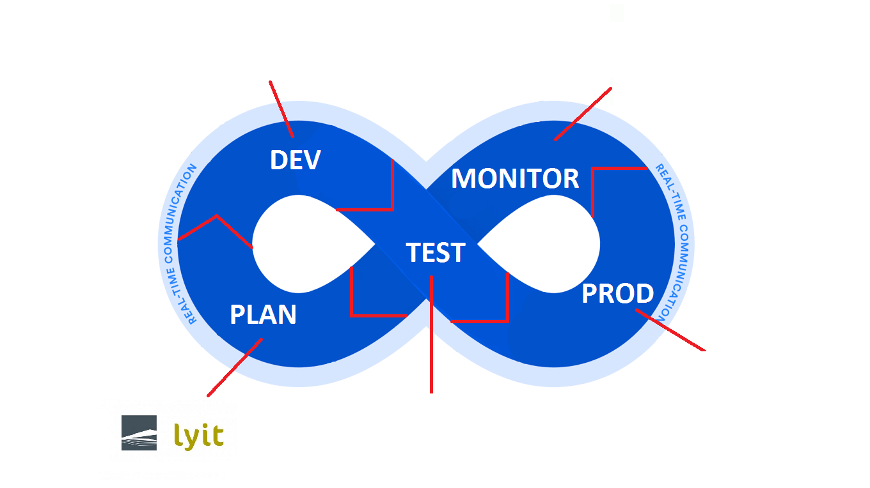
Pramerica / LYIT DevOps Interns Development Pipeline

Slide 7
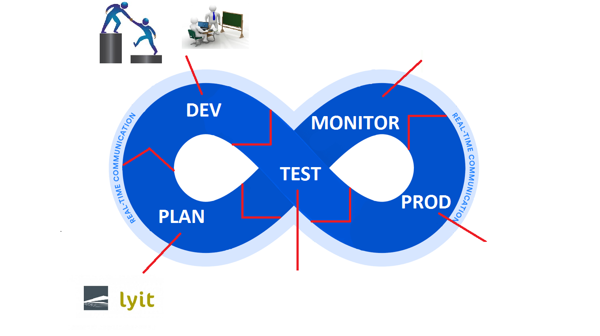
Pramerica / LYIT DevOps Interns Development Pipeline

Slide 8
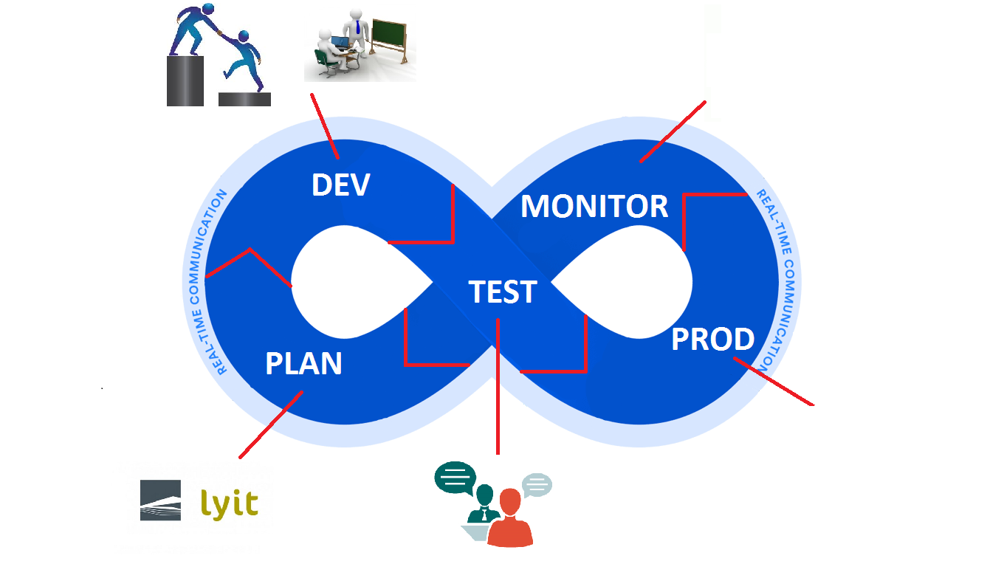
Pramerica / LYIT DevOps Interns Development Pipeline

Slide 9
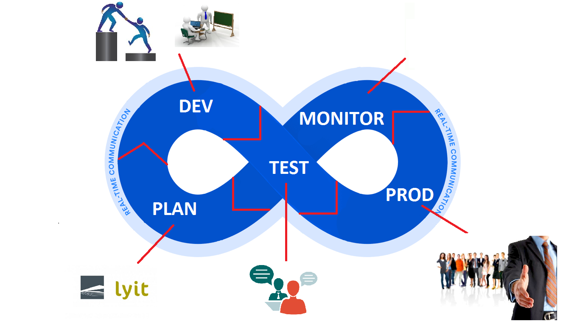
Pramerica / LYIT DevOps Interns Development Pipeline

Slide 10
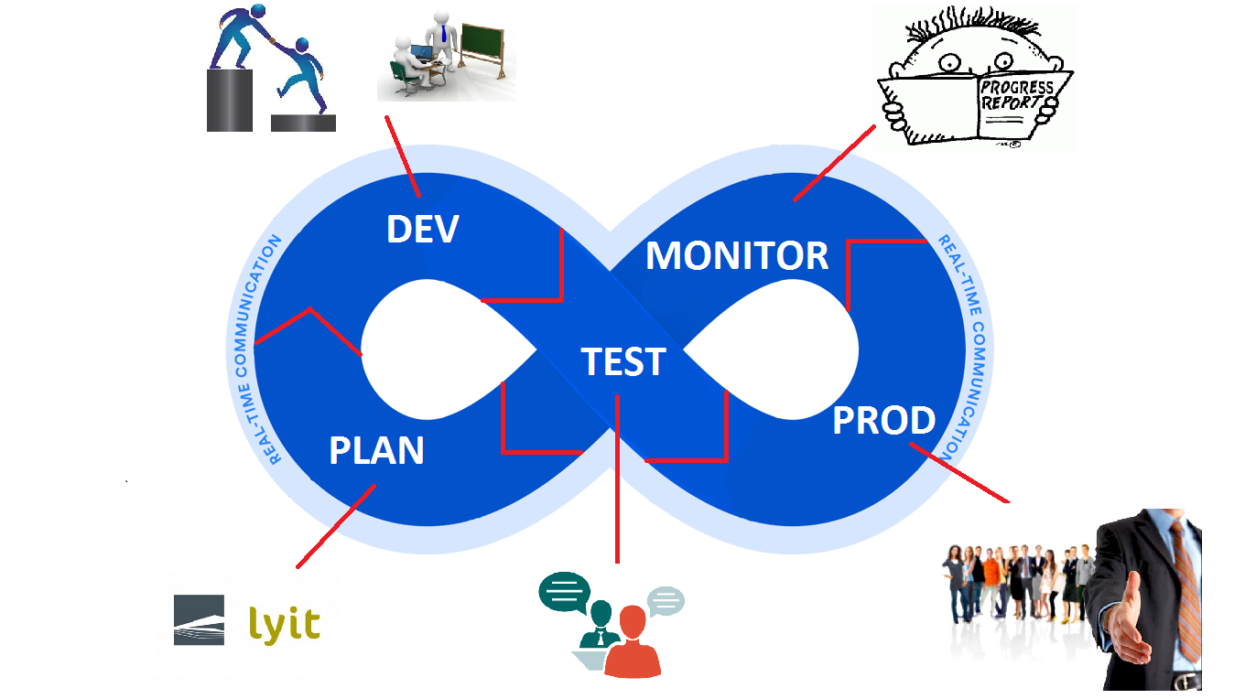
Pramerica / LYIT DevOps Interns Development Pipeline

Slide 11



Slide 12
Pramerica / LYIT DevOps Interns Development Pipeline
Thanks for Listening – Any Questions?

